Slide 1
FRB Update #4
William Huang
(6/26/2020)

Slide 2
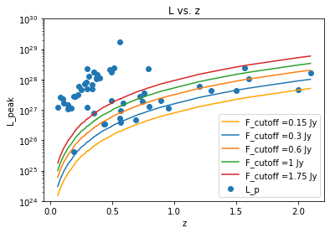
L vs. z
If only graphing L_p vs. z, there is only one graph, since the the peak luminosity and redshift don’t depend on which scheme to use for the limiting flux/luminosity. Thus, it is still the original graph, with a flux cutoff of 0.15 Jy. I’ve also added some other flux limits just for reference.

Slide 3
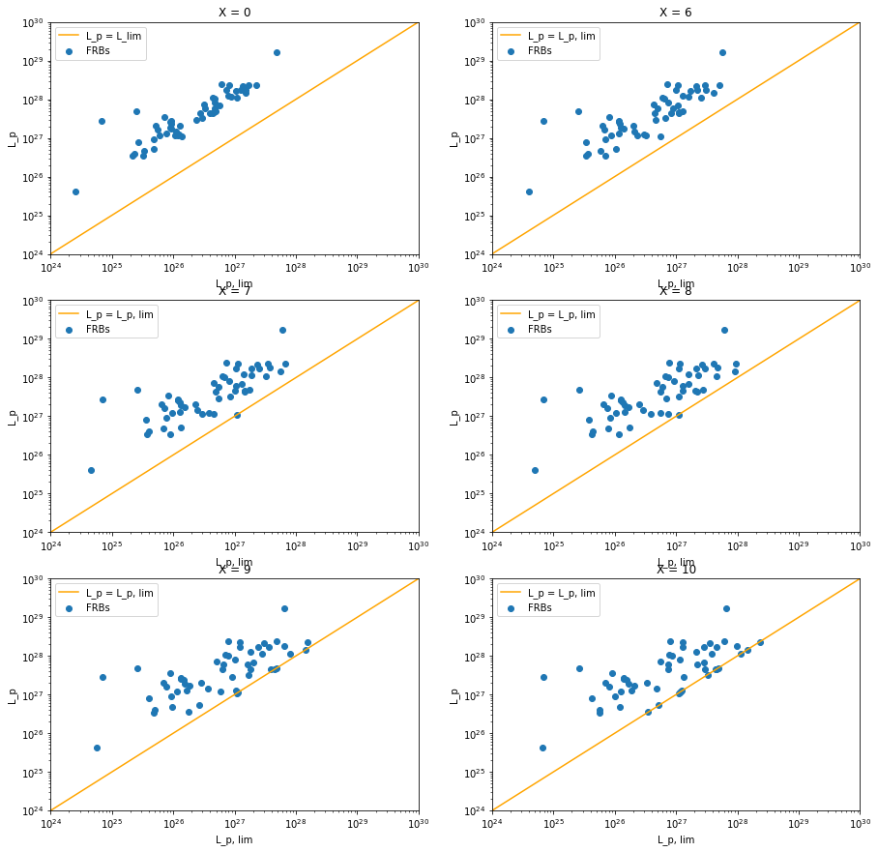
Using (S/N-X)
This time, plotting L_p on the y and L_{p,lim} on the x-axis:

Slide 5
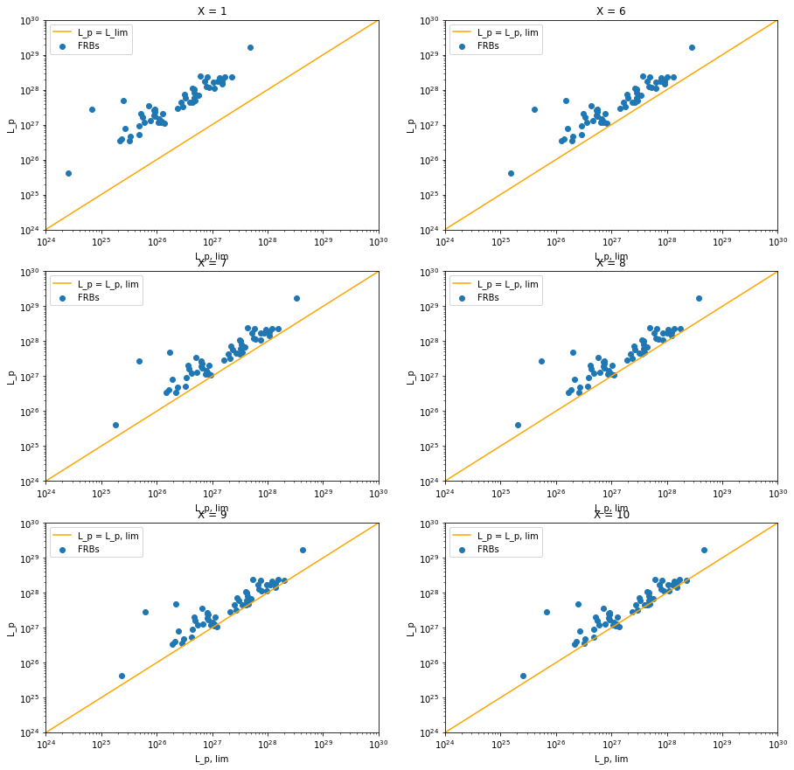
Using X/(S/N)
Using updated y and x axes again.

